Slide 1
Final Group Project
Group 3
Yasir Mohammad
Harsharan Gorli
Jamir Burns
Jonathan Schlepp
Melis Diken
Suyash Srivastava
Yuqi Wu

Slide 2
Brief description
We went about this project by first uploading the tables in their original form and running basic command line and SQL queries to get a better feel of the data.
After that, we came up with our analytical questions and then built a schema which would serve the primary purpose of answering our analytical questions.

Slide 3
Data sources
Cases and Deaths (04/12/2020 – 11/15/2021) Vaccine and People Vaccinated (12/10/2020 – 11/15/2021) Testing from the JHU datasets website
Education Scores per state from the WalletHub website
2020 Election data from the the Kaggle website
Population data from WorldPopulationReview

Slide 4
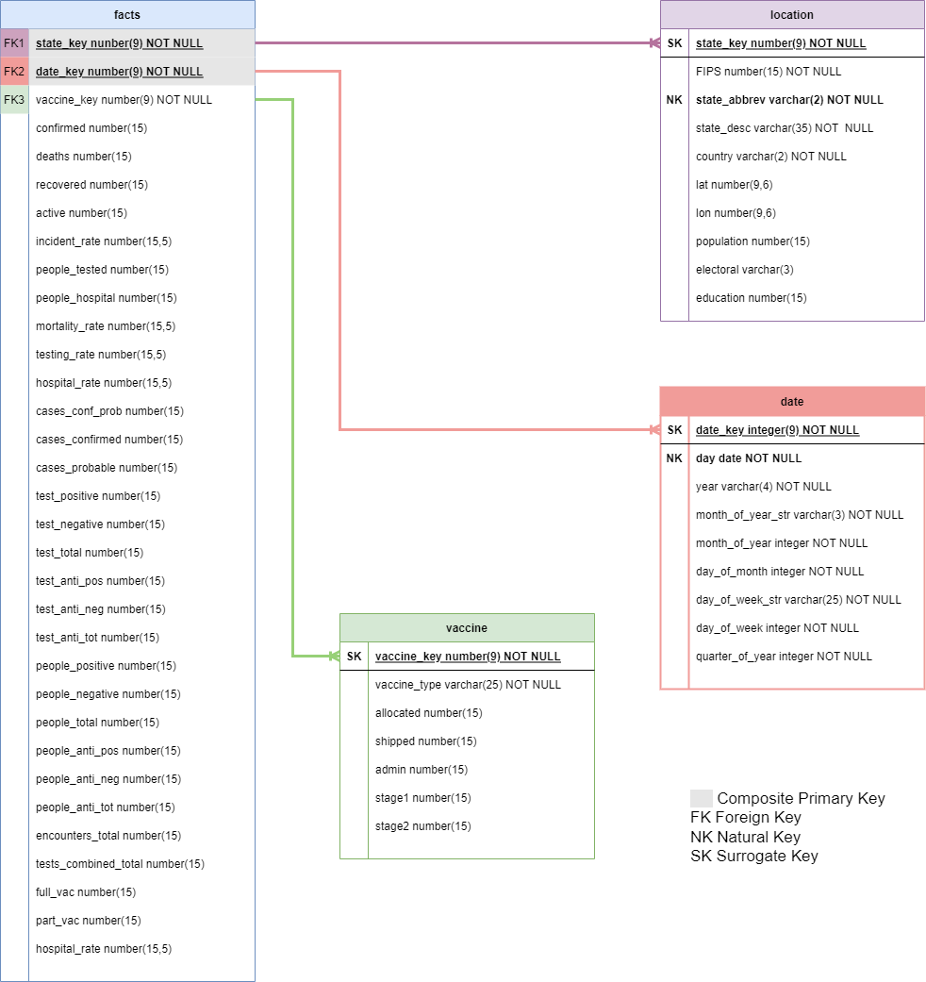
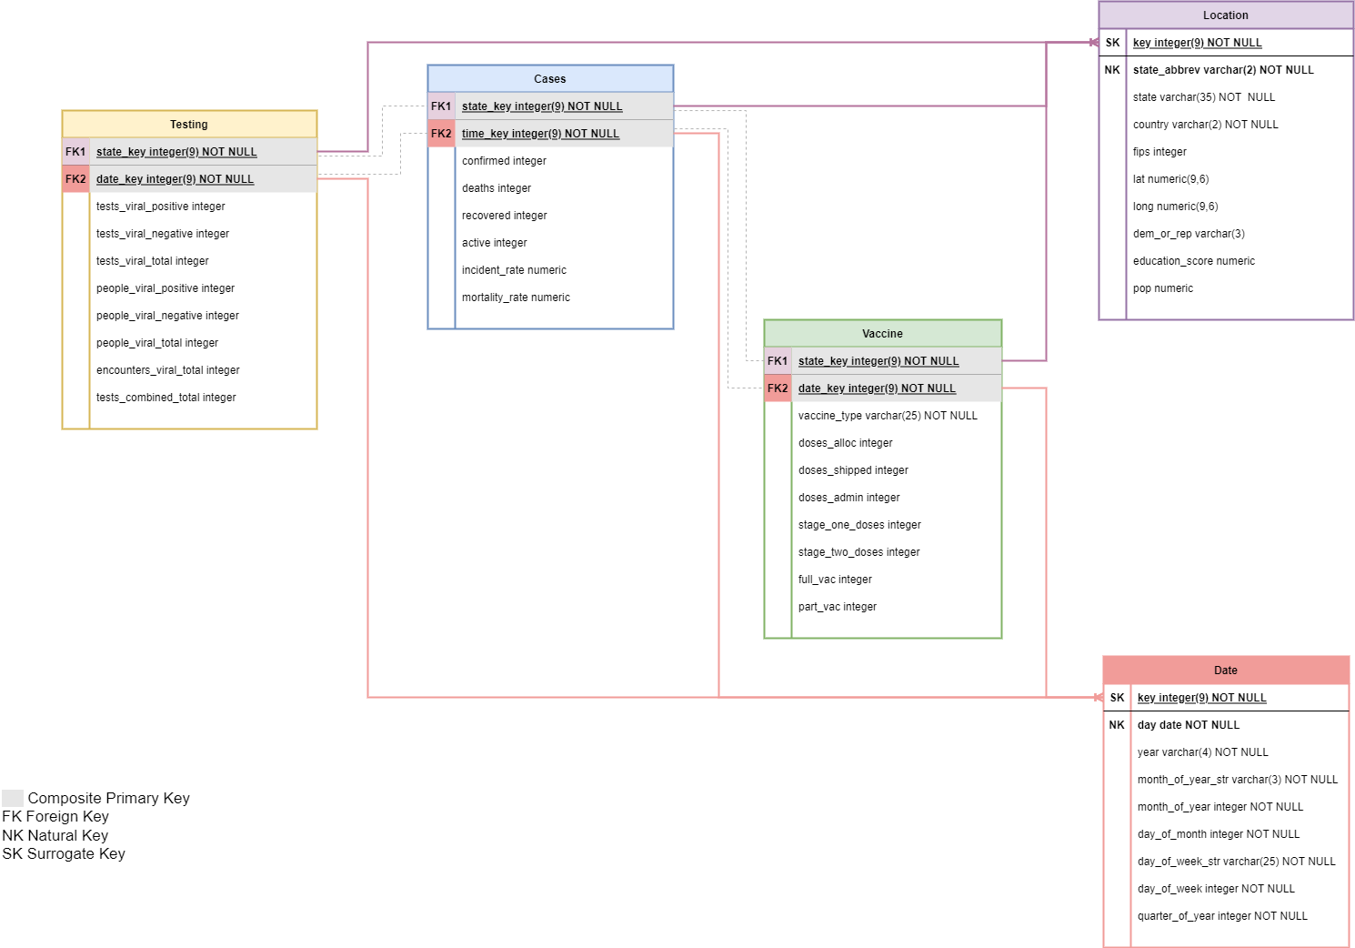
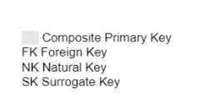
Schema & Dimensional Database
Scenario 1
Scenario 2
1 fact table
3 fact tables

Slide 5
Schema & Dimensional Database
Clean and Simple. Easy to interpret
Can use state key and time key to join
Added additional data to location table for analysis
Each solution it was important to keep vaccine type data separate

Slide 6
Analytical Questions

Slide 7
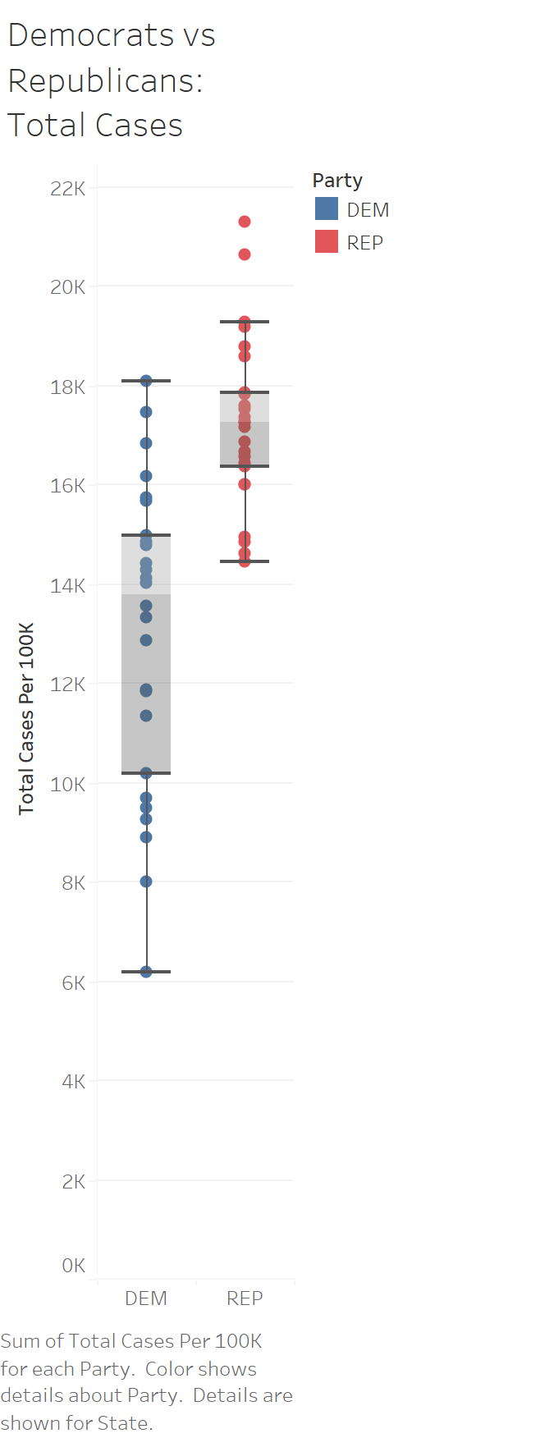
Question 1 - What effect did state party affiliation have on reported COVID cases?
North Dakota
Rep and Dem states determined using 2020 presidential election results
Alaska
Pattern shows that REP affiliated states have on average higher cases per 100k
Assumption that REP states appear to have less strict COVID mandates in place
Median of 17,249 cases (per 100k)
Median of 13,800 cases (per 100k)
Will a similar pattern be present for vaccination rates as well?

Slide 8
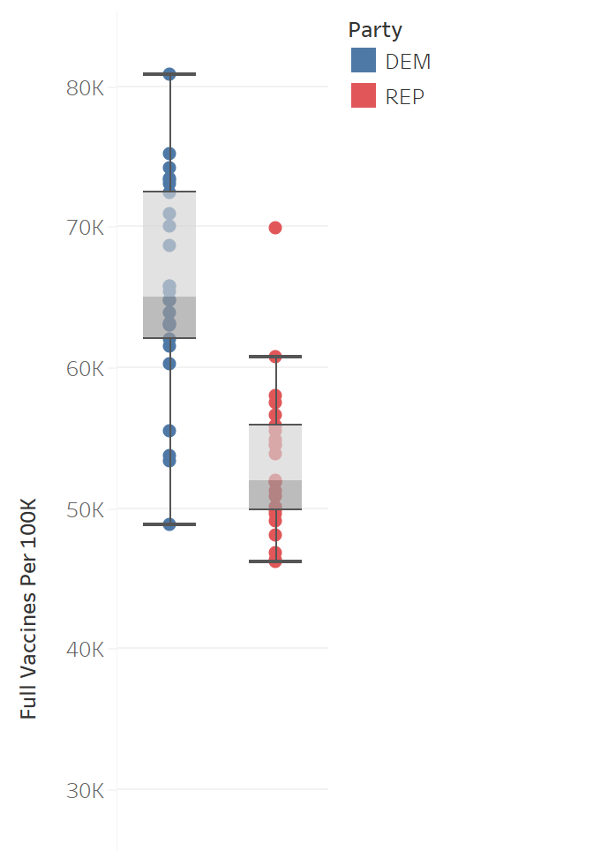
Question 1 - What effect did state party affiliation have on reported COVID vaccination rates?
Rep and Dem states determined using 2020 presidential election results
Pattern shows that DEM affiliated states have on average higher vaccination rates per 100k
Party affiliation does suggest a relationship with COVID related state policies
West Virginia
Median of 65,000 vaccinations (per 100k)
Median of 52,000 vaccinations (per 100k)
What other factors might be present regarding vaccination rates?

Slide 9
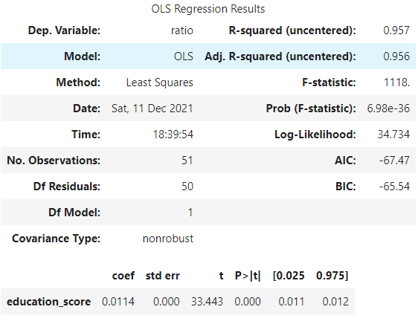
Question 2 - How does the quality of education affect the number of fully vaccinated people across different states?
DId single linear regression to predict the rate of fully vaccinated people per state using education scores
Strong relationship between the rate of fully vaccinated people and education scores per state as seen in our R-squared value of 0.957 and our p-value < 0.05 → statistically significant
It's a positive relationship between education rate and vaccination rate based on the upwards slope

Slide 10
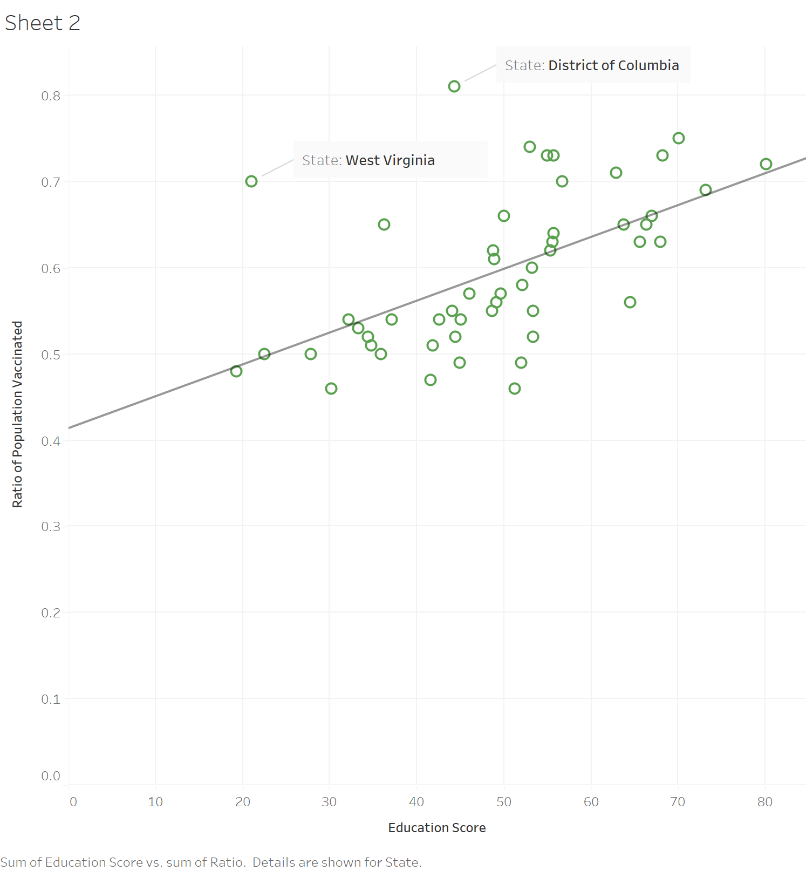
Question 2 - How does the quality of education affect the number of fully vaccinated people across different states?
We can see the positive relationship
The two biggest outliers are DC and West Virginia.
Since many government workers live in DC and several government vaccine mandates are in place, we can see a very high vaccination rate.
For West Virginia, as we discussed in question one, West Virginia had a very effective rollout so that is a possible explanation why it's an outlier.

Slide 11
Conclusion
Overall, we found the project extremely engaging and filled with insights.
Some of our favourite findings were the incredibly strong relationship between education and vaccination rate, as well as the stark disparity in cases amongst democratic and republican voting states.
One major takeaway would be the importance of designing a strong schema and comprehensive database to conduct thorough analysis. The stronger the database, the easier the analysis will be!

Slide 12
Thank you! Questions?

Slide 13
Question 3 - How did vaccination rates affect the total number of cases and and the total number of deaths over time?
-We can be reasonably sure that the roll out of vaccines within the U.S helped to minimize deaths and confirmed cases.
- After the vaccine rollout began in Feb. 2021, it can be noted that monthly percent change of Deaths and Cases fell and stayed relatively low in comparison to before the Vaccine rollout.

Slide 14
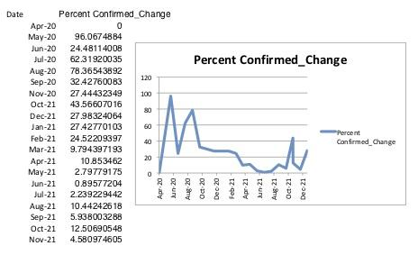
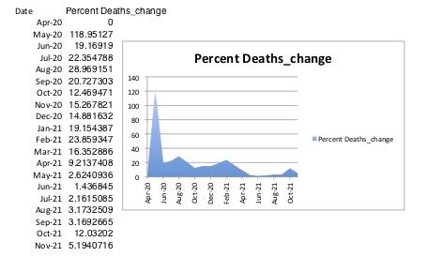
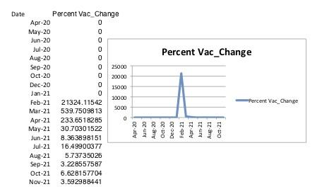
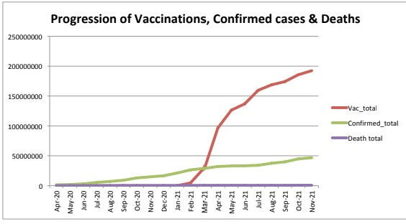

Slide 15
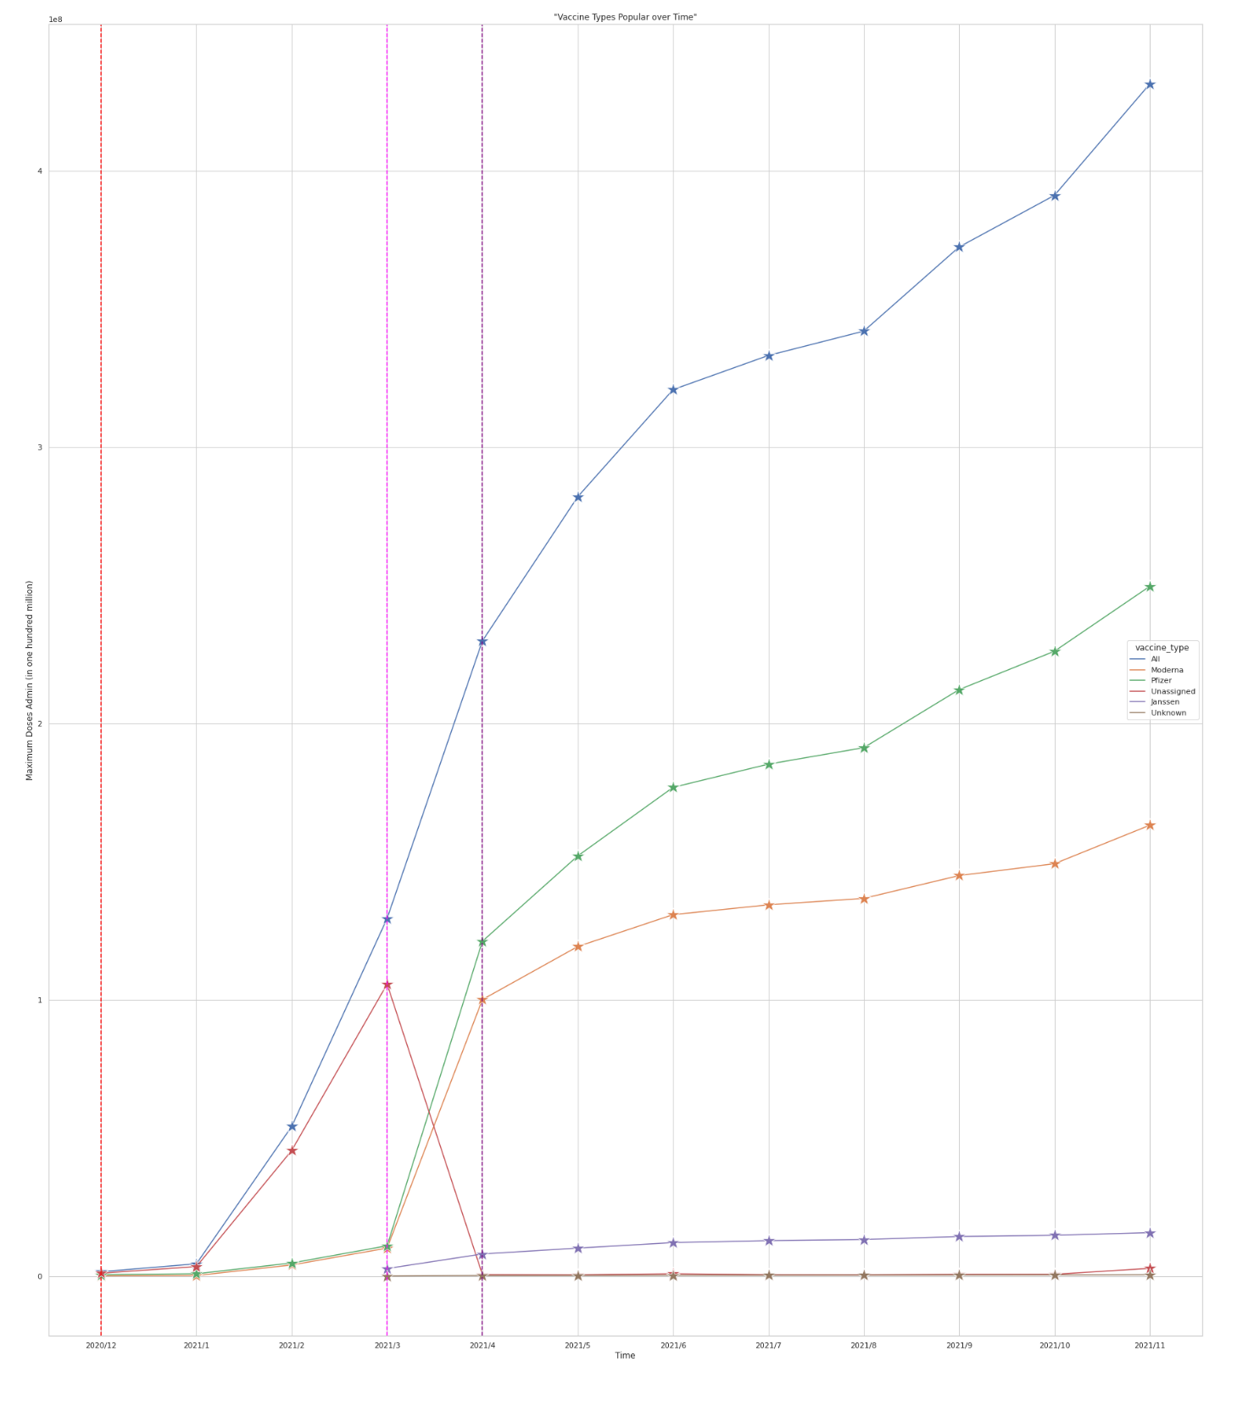
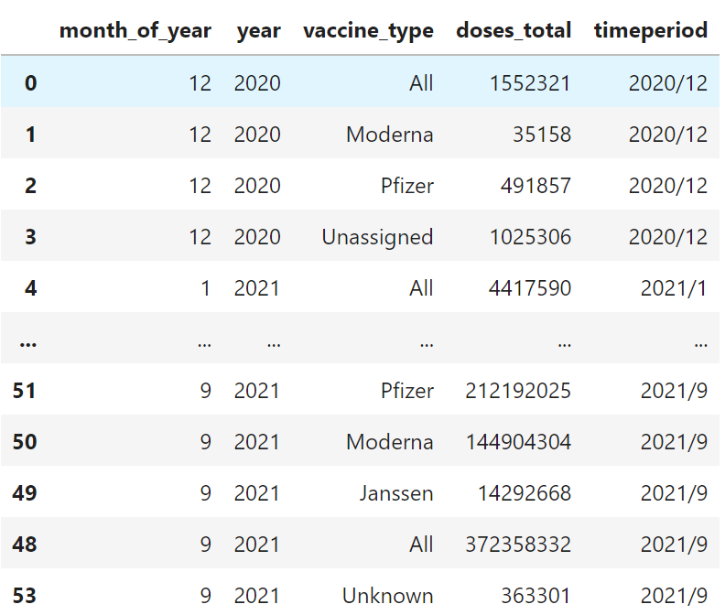
Question 4 - Which vaccine types were popular over time?
Analysis:
* A decline in the vaccine_type 'Unassigned' is observed after the FDA approves JnJ - here we can infer that JnJ's clinical trials ended and as such the number of drugs administered through the type 'Unassigned' reduced
* The lines that represent Morderna and Pfizer have an exponential increase in the month of March 2021 - here we can infer that this might be because the Acting HHS Secretary directed that vaccination was available for teachers, school staff, and child care workers
* We observe that Pfizer was more popular in the US when compared to Morderna (180 million) and JnJ (30 million) with about 260 million doses being administered across the US

Slide 16
Attestation
This statement is an attestation by all members of Group 3 that all members contributed equally to all 6 Asks of the project, and that each member has profound knowledge of each of our solutions to this project’s given tasks.

